Slide 1
DASHBOARD ACTIONS & ANALYSIS IN TABLEAU
James Larkin – Data Analytics Instructor

Slide 2
DASHBOARD ACTIONS AND ANALYSIS IN TABLEAU
OPENING

Slide 3
DASHBOARD ACTIONS AND ANALYSIS IN TABLEAU
LEARNING OBJECTIVES
After this lesson, you’ll be able to:
Develop interactive Tableau dashboards.
Practice analyzing data in Tableau.
Connect to data and build dashboards in Tableau.
Create actions within Tableau dashboards.
Apply your new skills to analyze some sample call records data.
Notes:
Call records data: You won’t believe what metadata can reveal about you!

Slide 4
DASHBOARD ACTIONS AND ANALYSIS IN TABLEAU
GUIDED PRACTICE: DASHBOARD ACTIONS

Slide 5
DASHBOARD ACTIONS AND ANALYSIS IN TABLEAU
Actions allow us to add interactivity to a dashboard so users can drill into the data via mouse clicking, hovering, and selecting data in a visualization.
In this guided practice, we will work through the data workflow, starting by connecting to data and eventually building out an interactive dashboard.
We will also learn how and why to use action filters when creating our dashboards.

Slide 6
ANALYSIS PROMPT
Context: Australia's new data retention laws mean phone and internet companies have to save this information for two years — that's every time you call someone, where you call them from, which cell tower your phone pings every time it connects to the internet, and more.
Prompt: On a mission to find out what that data might reveal, reporter Will Ockenden took a “surveillance selfie” and requested access to his own metadata. Using his sample, we can gain an understanding of the types of metadata individuals provide to cell phone carriers.

Slide 7
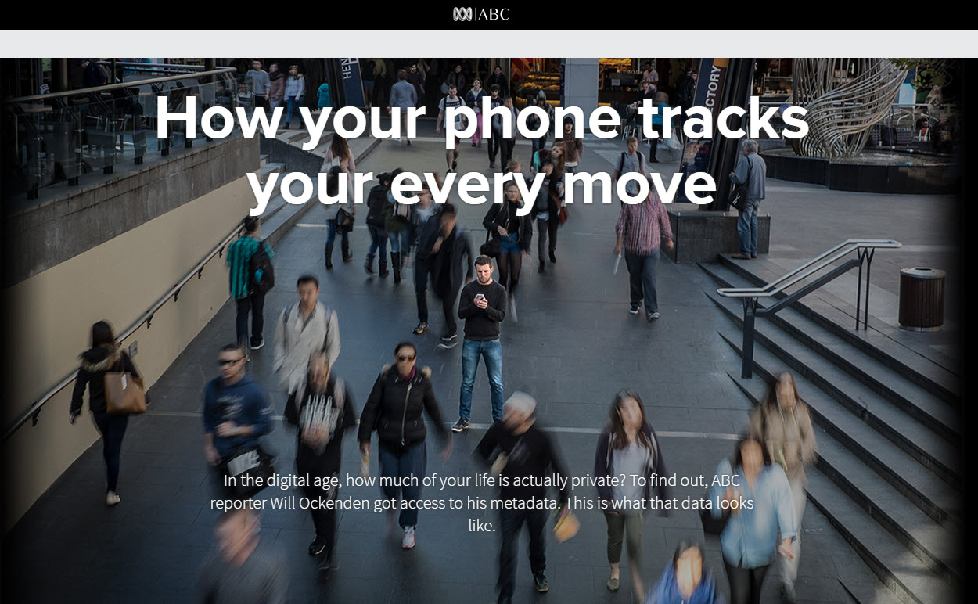
Notes:
Website of the actual ABC News project.

Slide 8
EXERCISE DATA SET
Description of the “wills_metadata.xlsx” dataset:
Comm type: Communication type (internet, call, SMS).
Cell tower location: Name of the cell tower that the signal went through.
Comm timedate string: The date and time of the record.
Comm identifier: Masked number to which the call/SMS was made.
Latitude/longitude: Coordinates of the cell tower location.
Notes:
This is the data dictionary for our Tableau activity, where we will be developing visualizations, dashboards, and Story Points using the wills_metadata.xlsx data set.

Slide 9
DASHBOARD ACTIONS AND ANALYSIS IN TABLEAU
INDEPENDENT PRACTICE: ANALYZE DATA

Slide 10

CALL RECORDS ANALYSIS
For the remainder of the class, we will use the “wills_metadata.xlsx’”data set to uncover information about Will.
The goal is to make a best guess at answering the following questions and use data and visualizations in Tableau to inform your answer.
Start by clicking on the “Connecting to Data” button in the Tableau main screen, using the “Excel file” option.
Notes:
Instructions to access the Excel source data set. It’s most convenient if this data set is already saved into a Tableau packaged workbook and distributed to the students in that format.

Slide 11
ACTIVITY: ANALYZE DATA
: PART 1
Take 15 minutes to answer this question:
Why do you believe the call records increase so dramatically in September 2014?
Create Tableau visualization(s) to support your answer.
Notes:
Answer: Will purchased a smartphone (and/or added data service to his existing phone), which is indicated by the uptick in mobile internet usage.

Slide 12
ACTIVITY: ANALYZE DATA
: PART 2
In groups, choose a single question from below about Will.
Take 20 minutes to develop a set of dashboards and Story Points to inform your answers.
Each group must present its dashboards and stories to rest of the class.
Where does Will work?
Where does Will live?
Where does Will’s family live (speculate)?

Slide 13
DASHBOARD ACTIONS AND ANALYSIS IN TABLEAU
REVIEW & DISCUSSION

Slide 14
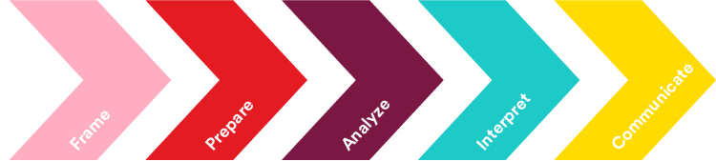
LET’S REVIEW
As we have seen, data can be analyzed in a number of ways with a number of different tools. For instance, we can apply calculations and aggregations in Excel, SQL, and now Tableau.
Therefore, the guiding principle from our data analytics workflow should always be to “choose the right tool for the task.”
Develop a hypothesis- driven approach to analysis.
Select, import, explore,
and clean data.
Structure, visualize, and complete analysis.
Make business decisions from data.
Present data-driven insights to an audience.
Notes:
Always consider the “right tool for the task.”

Slide 15


LET’S REVIEW: EXCEL
Excel is a general purpose tool for viewing, prepping, calculating, and graphing data:
As an unstructured analytical scratchpad, Excel makes it easy to perform quick, minor changes in small datasets when conducting an analysis.
Excel users can analyze data visually using PivotTables and graphs, but it takes more time and is much less effective than Tableau.
Updating data is not dynamic and is often tedious and error prone.
Notes:
Summary comments on tools.
Overarching thought: Always consider using the “right tool for the task.”

Slide 16


LET’S REVIEW: SQL
SQL is typically used to retrieve big data before performing analysis.
SQL can be used to analyze data sets that are much larger than Excel can handle.
SQL queries can be used to automate data collection and analysis.
However, one downside of SQL is that it requires writing a significant amount of code, making it a development-heavy tool.

Slide 17


LET’S REVIEW: TABLEAU
Tableau greatly streamlines analysis from a variety data sources:
Including handling basic data theory cleaning as needed (creating metadata which may be published as a shared Tableau data source file).
Tableau is excellent at visual analysis, quick calculation, and discovery through its unique flow of interactive visual query.
Suggested next step: Create a free account on Tableau Public, download the software (also free), complete your profile, and develop your portfolio.
Notes:
More closing comments on tools used in this course, including continuing no-cost access to Tableau (via the Tableau Public site and software version).

Slide 18
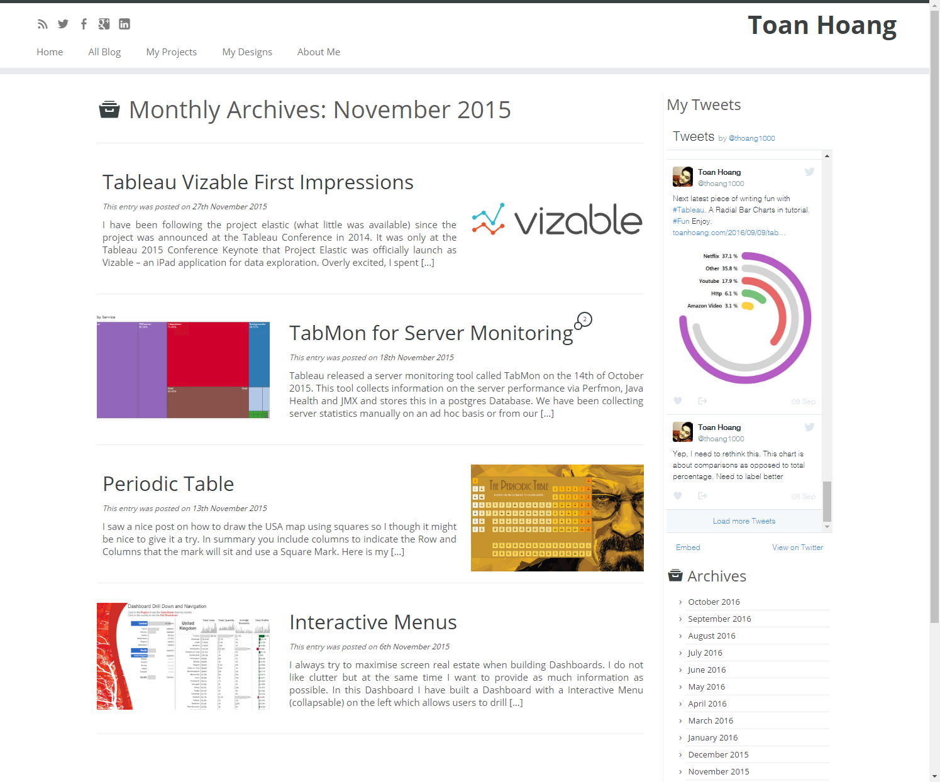
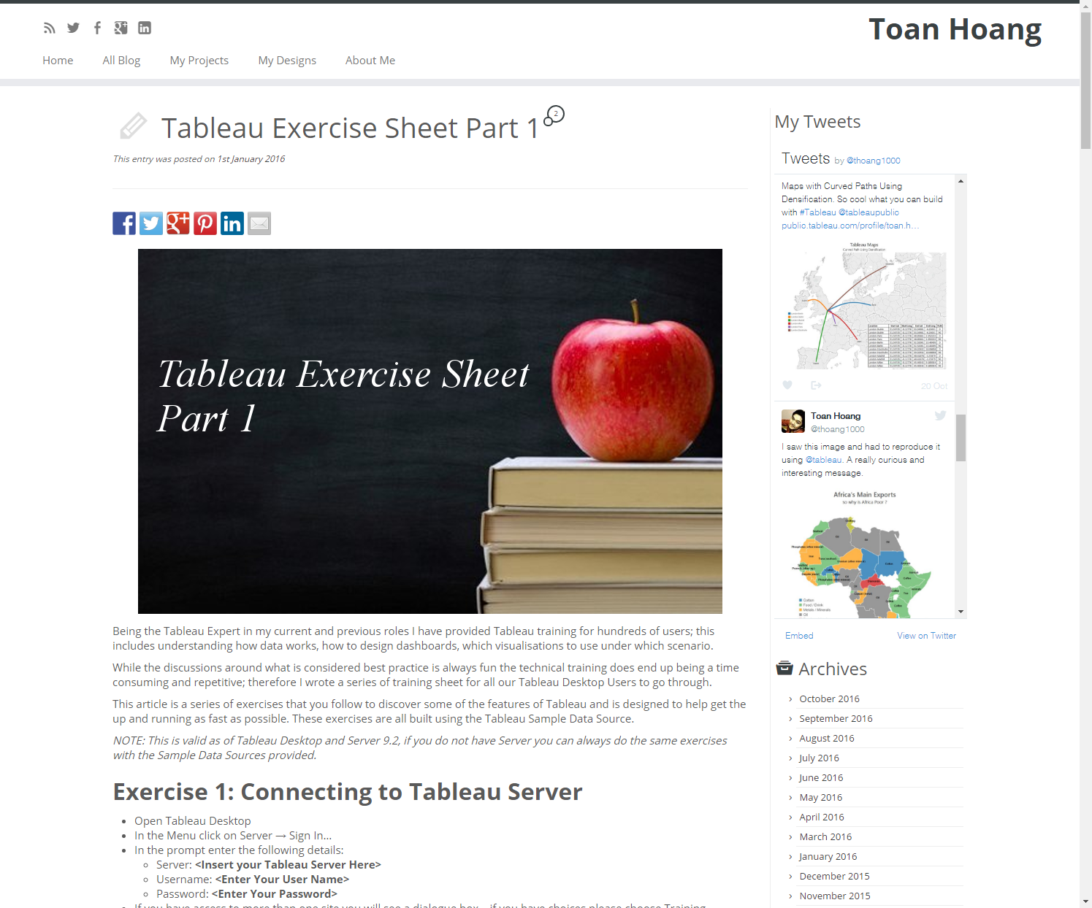
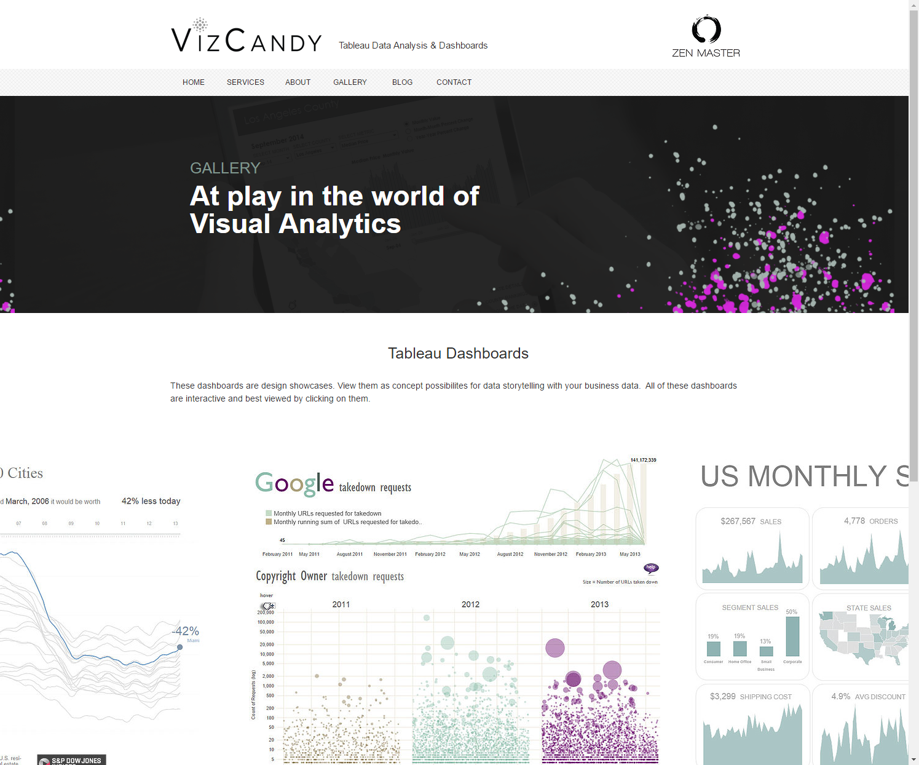
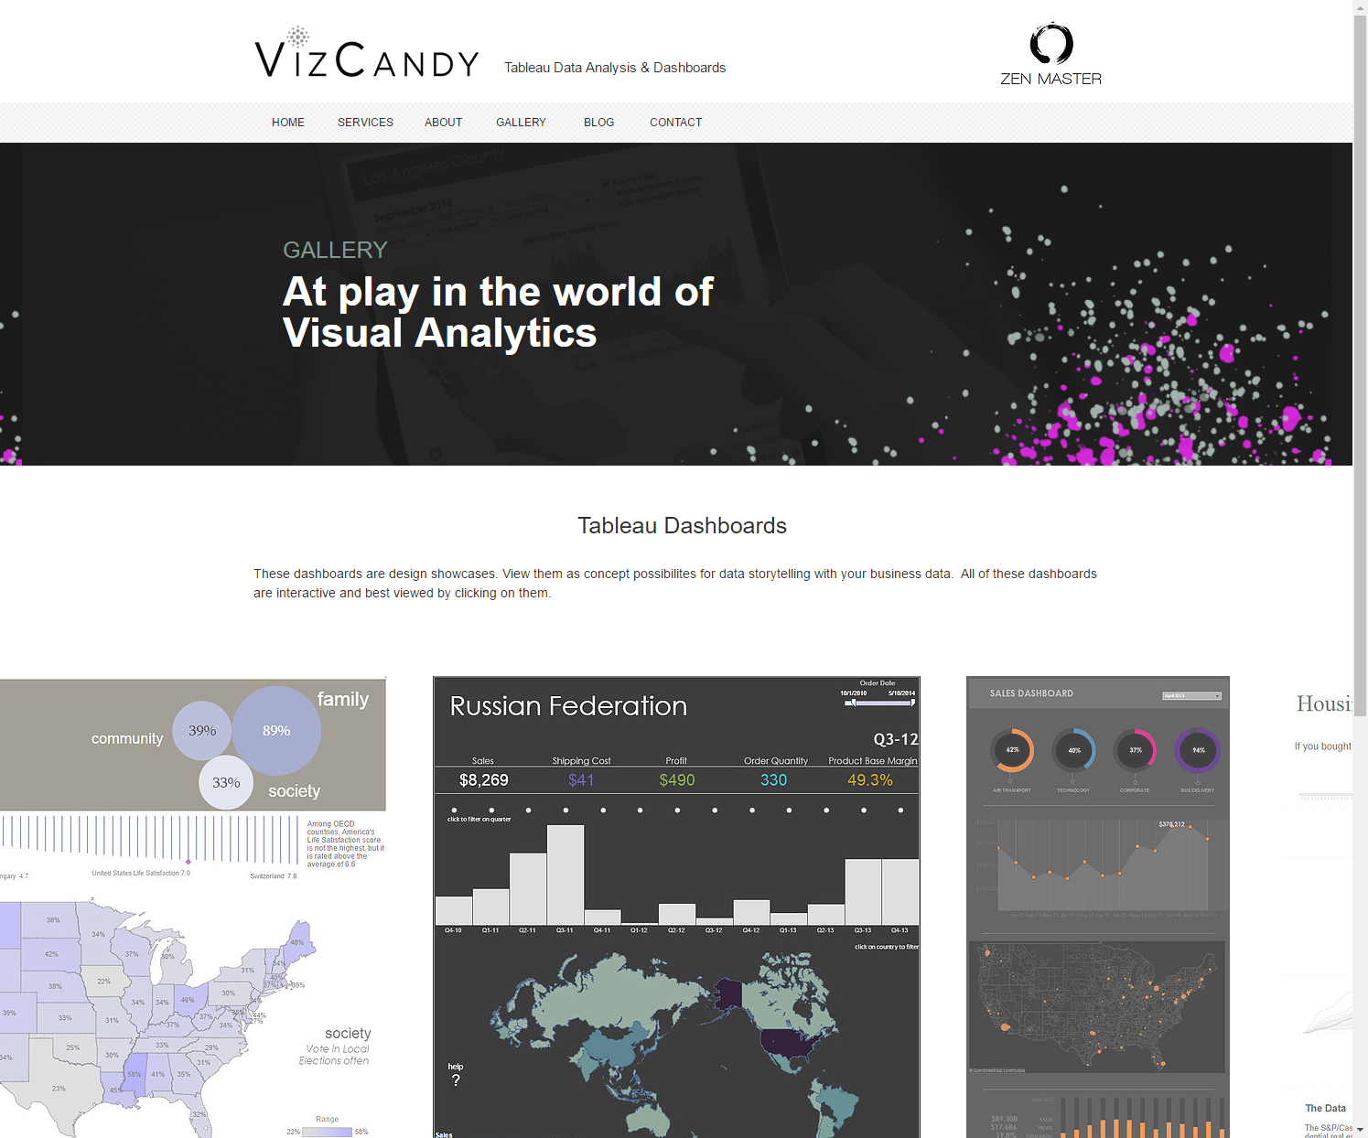
EXAMPLE PORTFOLIOS: TABLEAU
http://toanhoang.com/category/blog/
http://www.vizcandy.ca/gallery
Notes:
Example portfolio blogs (two of the best that illustrate the power of Tableau visualizations). Note: Wait for animation reveals. Recommend to students that they consider developing a blog to publish their analytics portfolio. It’s useful in seeking employment or advancement opportunities with current employers. Tableau Public allows for publishing one’s work to their own “Gallery,” which may be viewed by all or limited to one’s own private access.

Slide 19
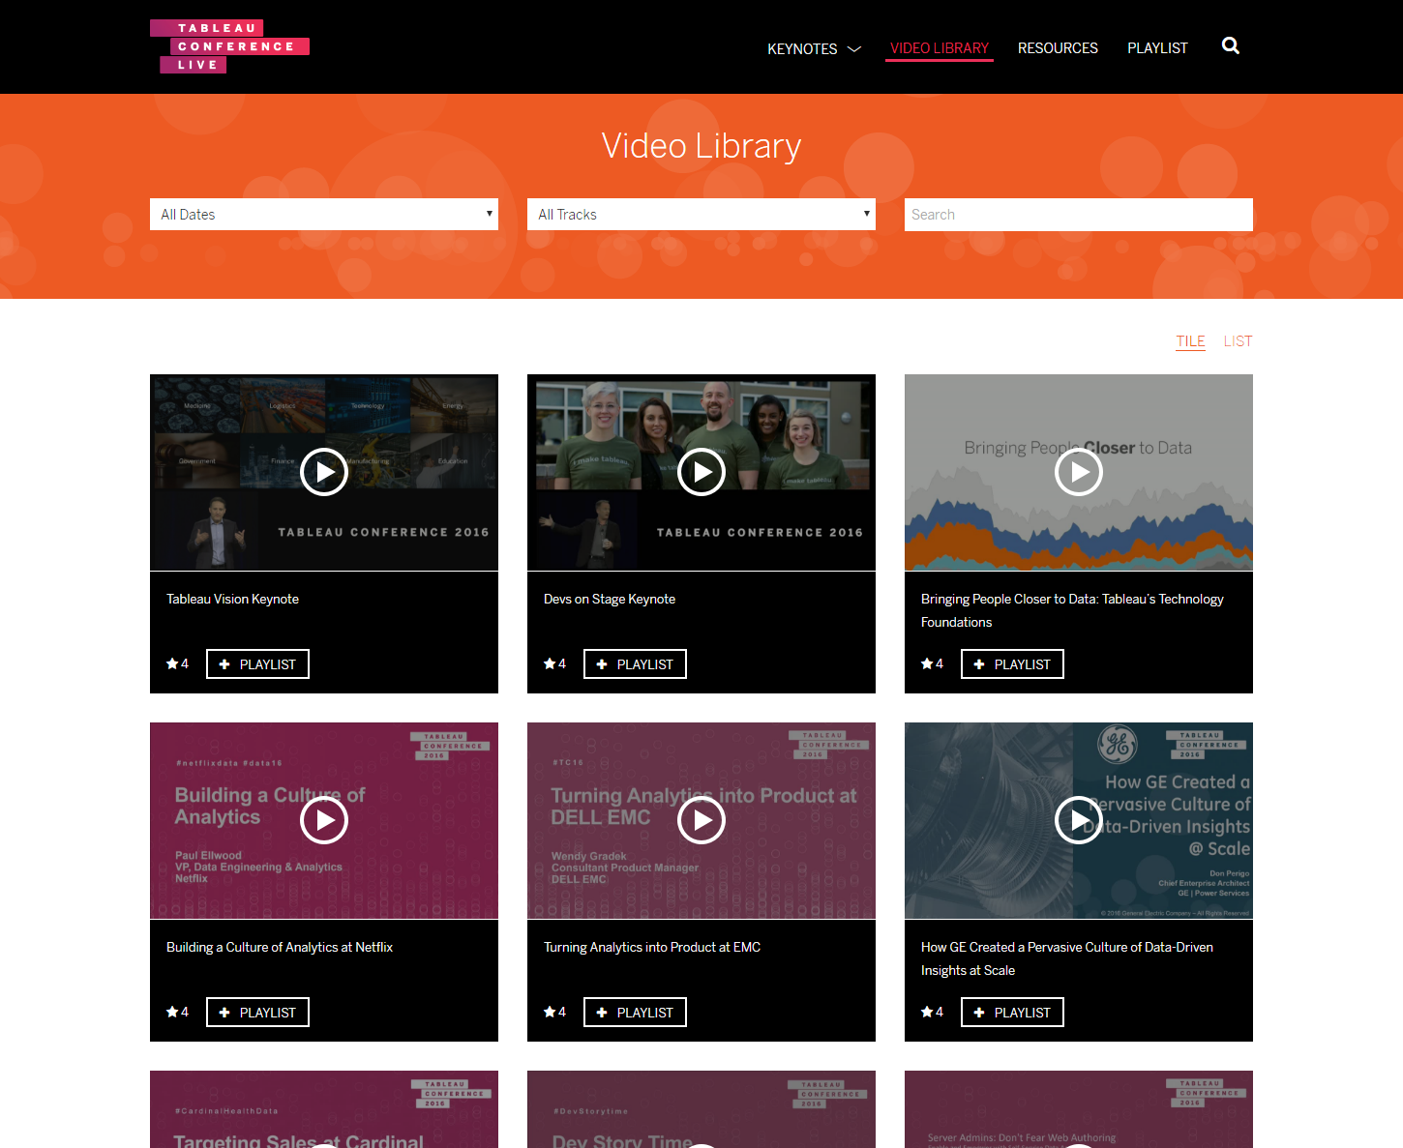
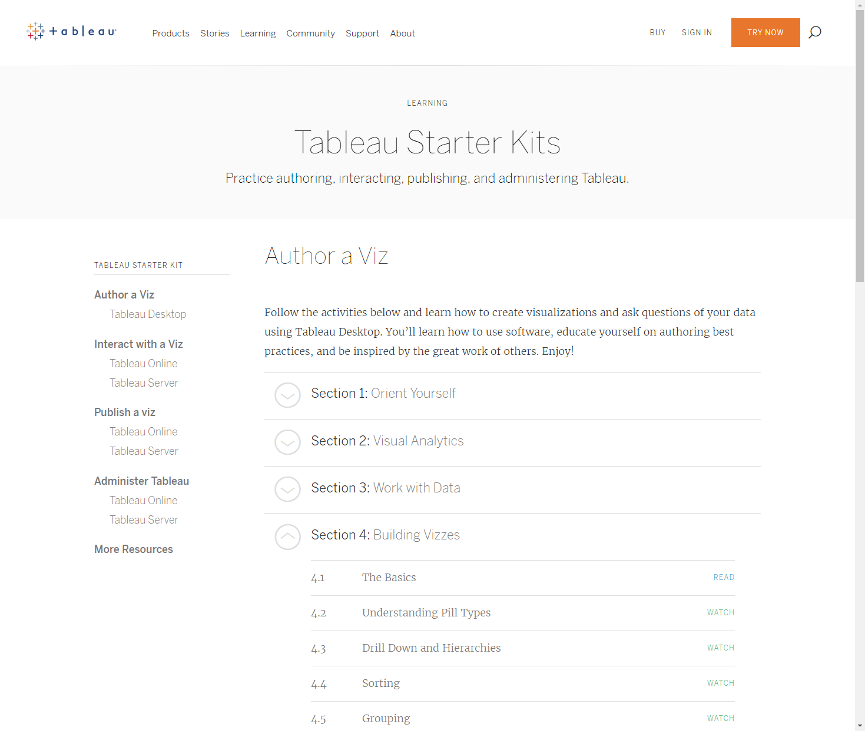
ADDITIONAL TABLEAU RESOURCES
http://tclive.tableau.com/Library/
http://www.tableau.com/learn/starter-kits
Notes:
Additional Tableau resources: Community, annual conferences, and additional online no-cost learning tools.
For more examples and resources, see our Student Resource Directory: https://drive.google.com/drive/folders/0Bx2SHQGVqWasQ0xfSG1DYTZ2WWM.

Slide 20
DASHBOARD ACTIONS AND ANALYSIS IN TABLEAU
CONCLUSION

Slide 21
REVIEW: DASHBOARD ACTIONS AND ANALYSIS IN TABLEAU
RECAP
In this lesson, we learned how to:
Analyze data visually in Tableau.
Join data to build visualizations and a dashboard.
Apply action filters to create powerful dashboards.
Analyze sample data.
Create visualizations, dashboards, and Story Points to answer questions.

Slide 22
UNIT REVIEW
Pair up and take 10 minutes to discuss:
Key takeaways from today.
What you can do to make these takeaways actionable and valuable for your teams.
Thought starters: Better knowledge of keys in databases; aligning with database teams on data organization.
Be prepared to share your answers with the class.

Slide 23
DASHBOARD ACTIONS AND ANALYSIS IN TABLEAU
RESOURCES

Slide 24
DASHBOARD ACTIONS AND ANALYSIS IN TABLEAU
RESOURCES
Creating Dynamic Titles Using Actions (Tableau): http://kb.tableau.com/articles/howto/creating-dynamic-titles-based-on-filters
Building a Story Point Analysis to Examine a Trend (Tableau): https://onlinehelp.tableau.com/current/pro/desktop/en-us/story_example.html
Gallery of Featured Tableau Visualizations (Tableau Public): https://public.tableau.com/en-us/s/gallery?qt-overview_gallery=1

Slide 25
ADDITIONAL RESOURCES: TABLEAU
Tableau has a vast library of resources and a global community.
If you have questions around usage, try community.tableau.com or reddit.com/r/tableau.
There is also a public repository of Tableau workbooks for inspiration on visualization techniques.
Lectures and workshops from TableauCon are available online.
Notes:
Additional Tableau resources: Community, annual conferences, and additional online no-cost learning tools.
For more examples and resources, see our Student Resource Directory: https://drive.google.com/drive/folders/0Bx2SHQGVqWasQ0xfSG1DYTZ2WWM.

